Slide 1
WPD Data Management App
Team:We Can Do It
Dhari, Abdulrahman, Elina, and Andrew
Notes:
Hello, everyone! We are the We Can Do It team and the project our team is working on for Senior Design is a data management application for the Wichita Police Department.

Slide 2
About We Can Do It
Dhari (CE) - Team Lead
Mobile / Backend Development
Abdulrahman (EE) - Project Manager
UI/UX
Elina (CS) - Scribe
Database Development
Andrew (CS) - Team Facilitator
Front end Development

Slide 3
Project Description
The Problem:
The WPD is having trouble organizing and keeping track of their paperwork when interacting with victims of crimes.
The Solution:
We are making the interaction between police officers and victims easier by creating an app that will help manage data and allows citizens to be sent all the necessary documents and information through their phones.
Notes:
As mentioned earlier, we are working on a data management app for the Wichita Police Department. The issue at hand is that whenever the WPD is assisting or interacting with victims or citizens, they have resources that they need to give these citizens depending on what kind of case they are currently working on. Because there are so many different kinds of cases such as traffic incidents or theft, there is never a guarantee that the office on the case will have the enough paperwork available that day. And it is very common for people to lose track of papers that are given to them. As a way to combat this issue, the WPD thought of an idea to create a digitized way to still communicate these resources and information to the citizens, but without the complications of paperwork, using their phones. In today’s day and age, everyone has a mobile phone and when information is stored digitally, it is a lot easier to keep track of. This also eliminates the risk of officers not having enough of one pamphlet or paper during a time of need.

Slide 4
Front-End
Development
Andrew
Notes:
Front-end development plays a big role in this project as there has to be an easy way to provide useful/helpful information through the web app. We have to condense down the information on the WPD pages since the websites are packed with information
And can be overwhelming for users to navigate through. Instead of users having to navigate through dozens or even hundreds of webpages, the officers want to be able to send specific information catered towards the types of call or crime the users dealing with
And that minimizes the amount of work and amount of time that the user has to spend. It also decreases the likeliness that the user can’t find helpful information.

Slide 5
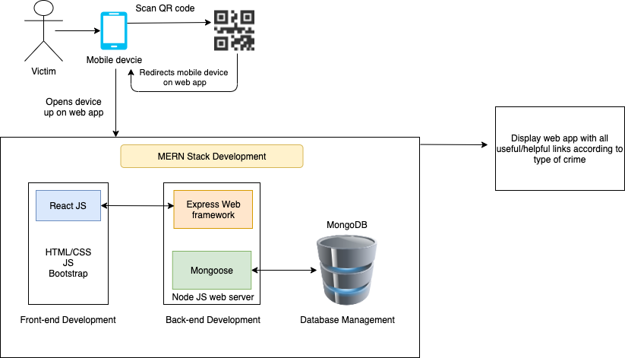
Notes:
Talk about the diagram
I chose to use the MERN stack since the team went with MongoDB because it is highly scalable and easy to manage.
React is highly supported through FaceBook and used within a lot of the top companies
Express and Node is what I went with for backend because it is easy to communicate not only with the front-end but also with mongoose and the mongodb in general.

Slide 6
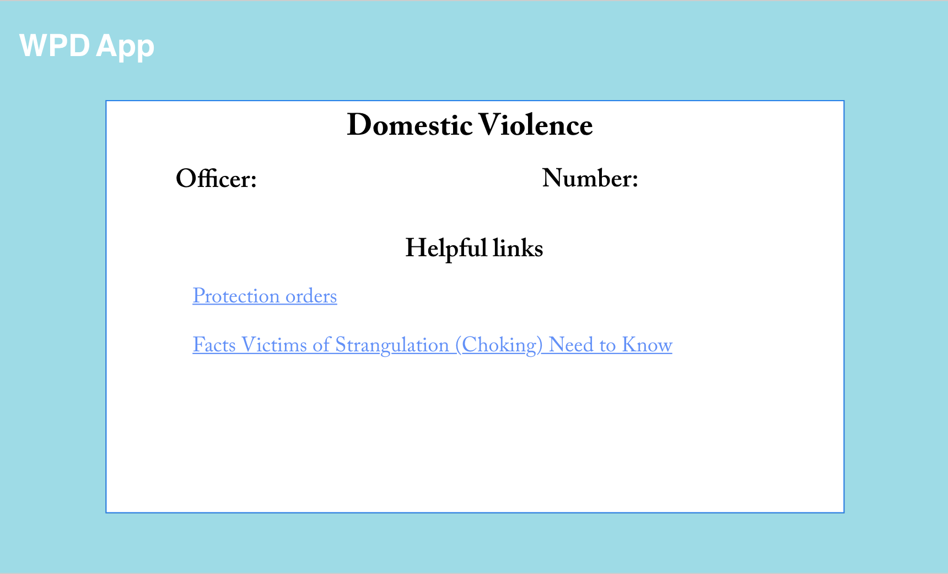

Slide 7
Mobile & Backend
Development

Slide 8
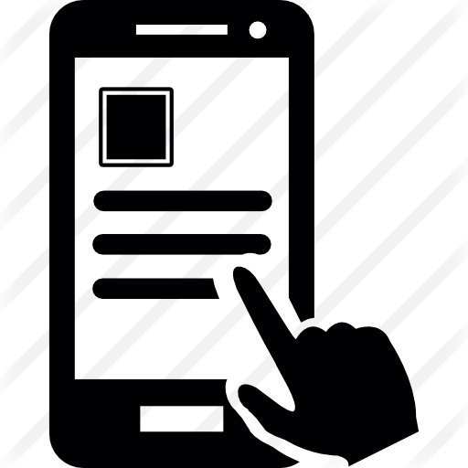
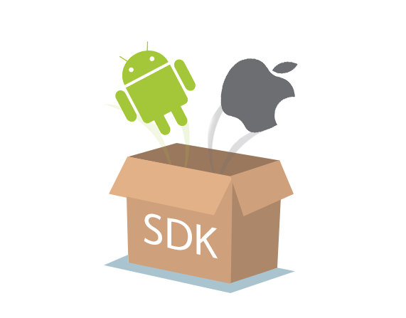
Mobile Development
Software Development Kit

Slide 9


Slide 10
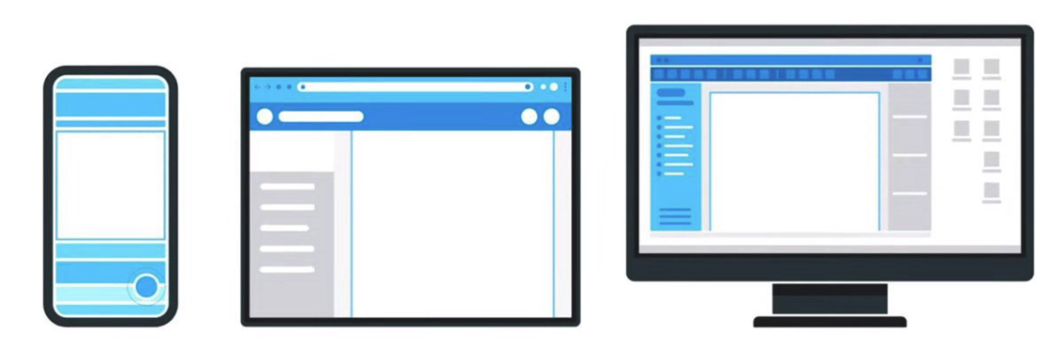
Why Flutter?
High Performance
Expressive and Flexible UI
One single codebase for many platforms

Slide 11
Backend Side (Server)

Slide 12


Slide 13
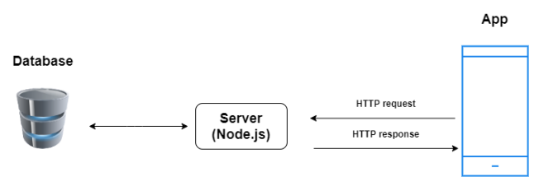
Why do we need a server?
Update the data to the latest version of the database
authentication

Slide 14
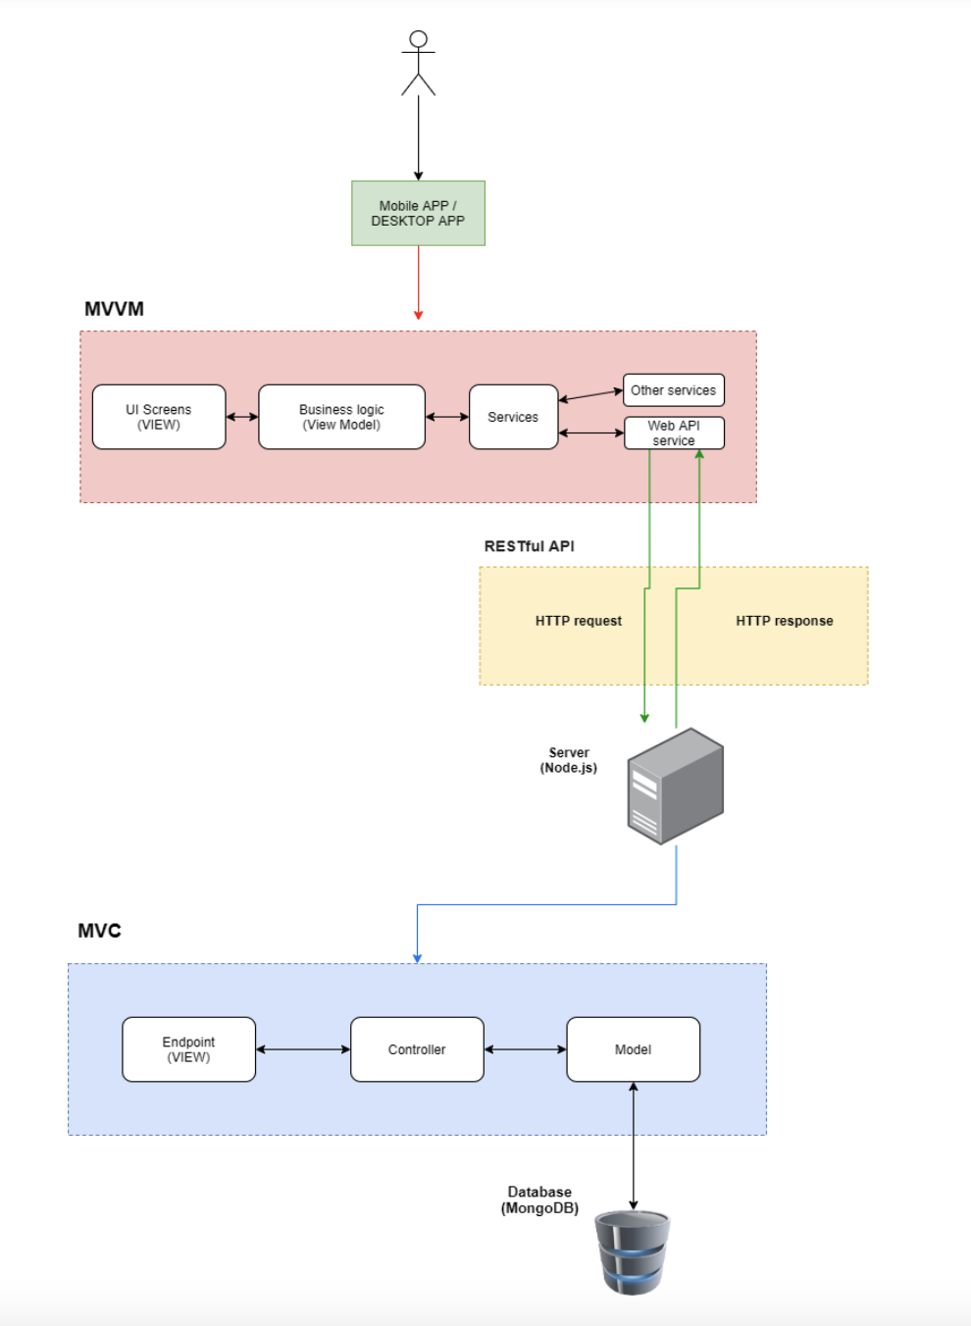
Communication method between the App and the Server

Slide 15
UI/UX
Design

Slide 16
UI & UX Design
Initial Design
Walkthrough the interactive Prototype on Adobe XD

Slide 17
Database
Development
Elina
Notes:
Hello! My name is Elina Do and I am majoring in Computer Science. As mentioned before, I am the scribe for the We Can Do It team and will also work on the database development for our project.

Slide 18
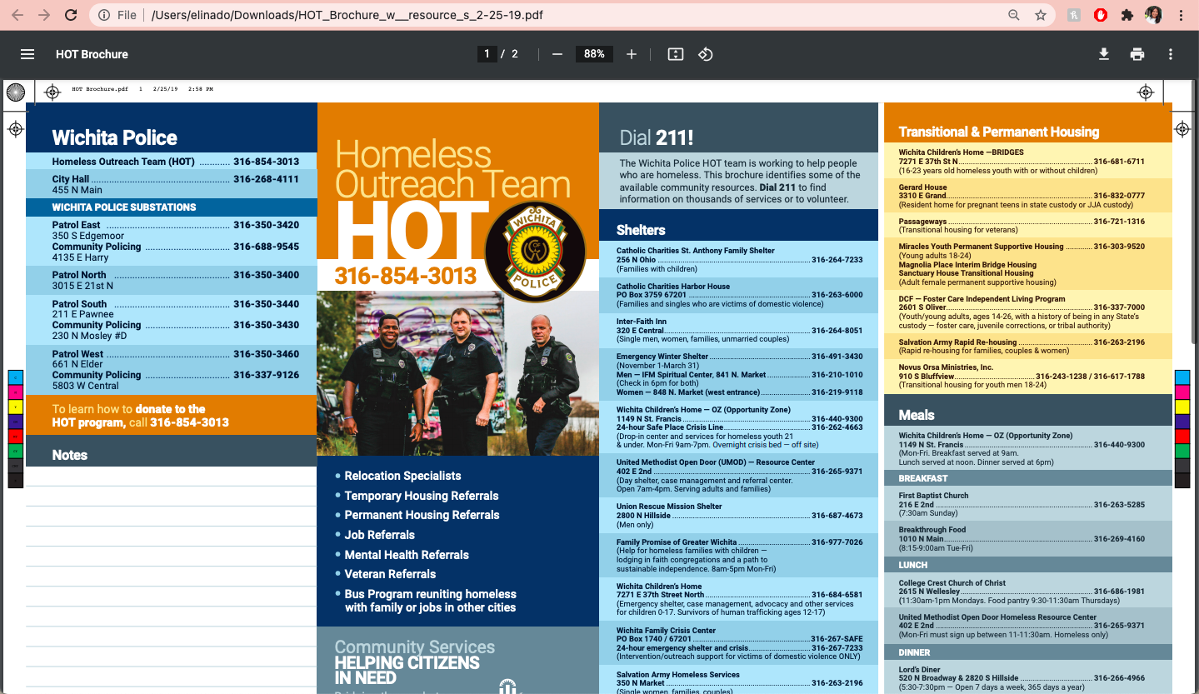
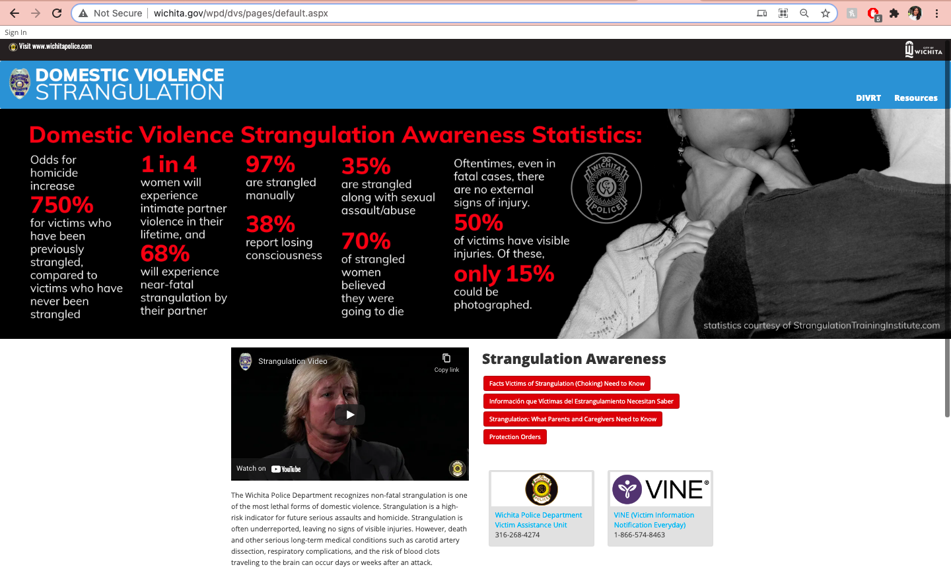
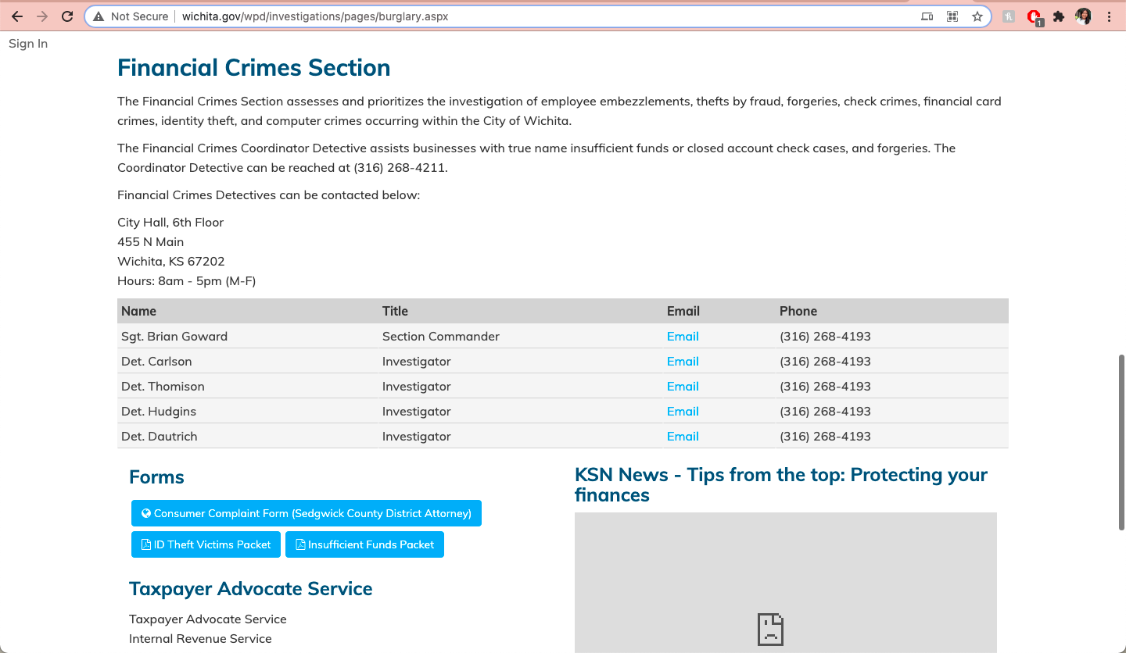
Elina
Notes:
When the Wichita Police Department first approached us with this project, we were unsure of what they were really asking of us. After meeting with them and asking questions that we had, we began to understand that they were needing us to essentially create a data management app. On the screen right now are some examples that we were sent as to what data the WPD wants managed on this app amongst other things. They sent us links to brochures, forms, websites, contact information, and other important information. As you can see, all of these websites are packed with information that may be overwhelming to users who are unfamiliar with navigating the internet. The WPD wants this information to be delivered in an easy-to-read and easy-to-access manner to victims via the application.

Slide 19
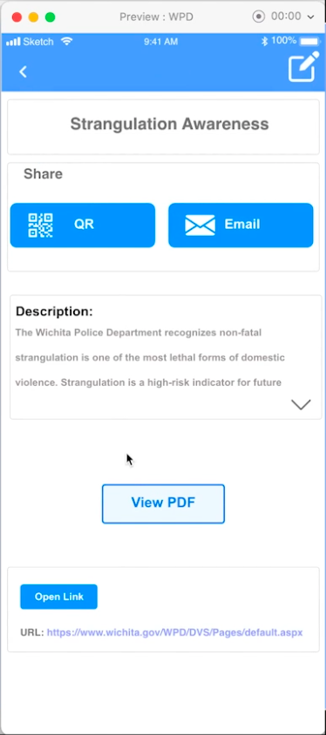
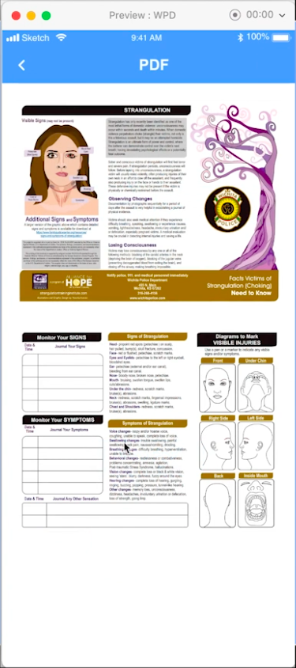
Elina
Notes:
All of the brochures and documents seen on the previous slide will be linked using our database. The way our app will work is it will send requests to the server to get the most recently updated data, then the server will receive the request from the mobile app. After that, the server will communicate with the database to get the data. Which would be whatever resources or information the victim needs for the interaction at hand.
We will be syncing the data on the backend to help keep the phone synced to the web-based program as well as updatable. This will also help keep the data on the phone storage to keep the data offline. This will be useful when certain websites or pamphlets are modifed, that way the victims will get the most up-to-date resources possible.
For our database development,

Slide 20

Elina
Notes:
For our project, we needed to look for an appropriate database in order to store the latest data update. As stated before, the database will need to help us keep the data in the mobile application synchronized with the last update. The app will communicate with the data through the server that was developed by the node. To do all of this, we also need a database that is very fast and one that has easy scalability. Because of these reasons we researched many different databases for our project. After looking into a variety of databases and comparing them, we found that MongoDB is best suited for our project. This is because it fills the criteria of being an easy, scalable database. MongoDB is also very flexible, the scalability inside of it is easier compared to other databases such as MySQL. In addition, MongoDB is significantly faster at inserting and updating a large number of records. Which will be useful when the mobile app updates the data continuously.

Slide 21
Thank you!

